Slide 1

Chapter 32 JavaBeans and Bean Events

Slide 2
Objectives
To describe what a JavaBeans component is (§32.2).
To explain the similarities and differences between beans and regular objects (§32.2).
To develop JavaBeans components that follow the naming patterns (§32.3).
To review the Java event delegation model (§32.4).
To create custom event classes and listener interfaces (§32.5).
To develop source components using event sets from the Java API or custom event sets (§32.6).

Slide 3
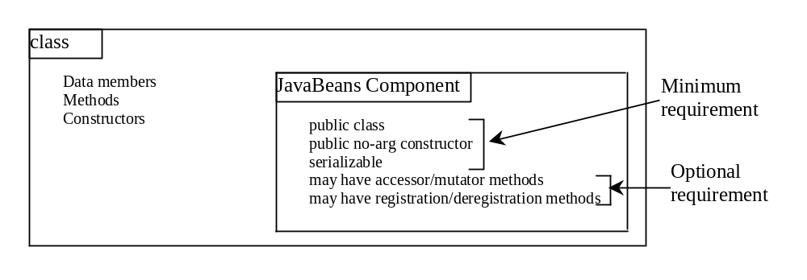
What is JavaBean?
A JavaBeans component is a serializable public class with a public no-arg constructor.
Every GUI class is a JavaBeans component, because (1) it is a public class; (2) it has a public no-arg constructor; (3) It is an extension of java.awt.Component, which implements java.io.Serializable.

Slide 4
Why JavaBeans?
The JavaBeans technology was developed to enable the programmers to rapidly build applications by assembling objects and test them during design time, thus making reuse of the software more productive.
JavaBeans is a software component architecture that extends the power of the Java language by enabling well-formed objects to be manipulated visually at design time in a pure Java builder tool, such as JBuilder and NetBeans.

Slide 5
JavaBeans and Builder Tools
NOTE: This chapter does not require that you use any builder tools. If you are interested to use JavaBeans in rapid Java application development using JBuilder or Sun ONE Studio, please refer to Supplement I, “Rapid Java Application Development Using JBuilder” or Supplement J, “Rapid Java Application Development Using Sun ONE Studio,” on the companion Website.

Slide 6
JavaBeans Properties and Naming Patterns
The get method is named
  get<PropertyName>(),
which takes no parameters and returns an object of the type identical to the property type.
For a property of boolean type, the get method should be named
  is<PropertyName>(),
which returns a boolean value.
The set method should be named
  set<PropertyName>(newValue),
which takes a single parameter identical to the property type and returns void.

Slide 7
Properties and Data Fields
Properties describe the state of the bean. Naturally, data fields are used to store properties. However, a bean property is not necessarily a data field. For example, in the MessagePanel class in Example 12.5 in Chapter 13, you may create a new property named messageLength that represents the number of the characters in message. The get method for the property may be defined as follows:
  public int getMessageLength() {
  return message.length();
  }
NOTE: A property may be read-only with a get method but no set method, or write-only with a set method but no get method.

Slide 8
Bean Events
A bean may communicate with other beans. The Java event delegation model provides the foundation for beans to send, receive, and handle events. When something happens to a bean, such as a mouse click on a javax.swing.JButton bean, an event object is created to encapsulate information pertaining to the event. The bean passes the event object to the interested beans for the event to be processed.
Events are typically generated by Java GUI components, such as javax.swing.JButton, but are not limited to GUI components. This section introduces the development of custom events and the beans that can generate events.

Slide 9
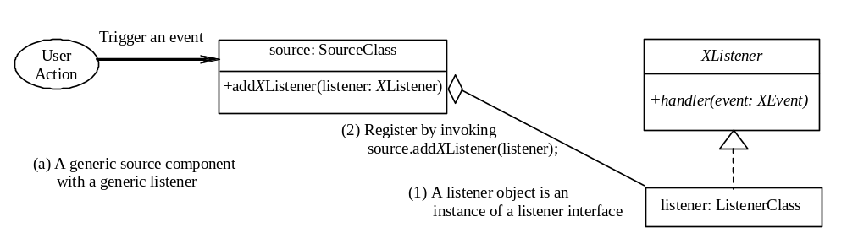
The Event Delegation Model
Figure 15.3

Slide 10
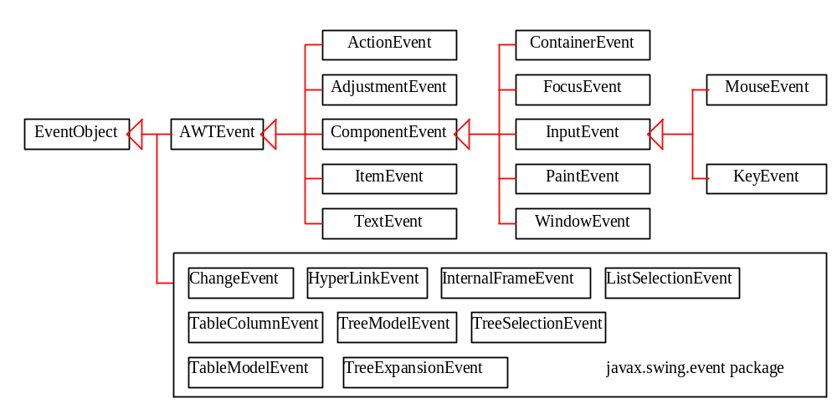
Predefined Event Pairs
(Event Classes and Listener Interface)
Examples:
  ActionEvent/ActionListener
  AdjustmentEvent/AdjustmentListener

Slide 11
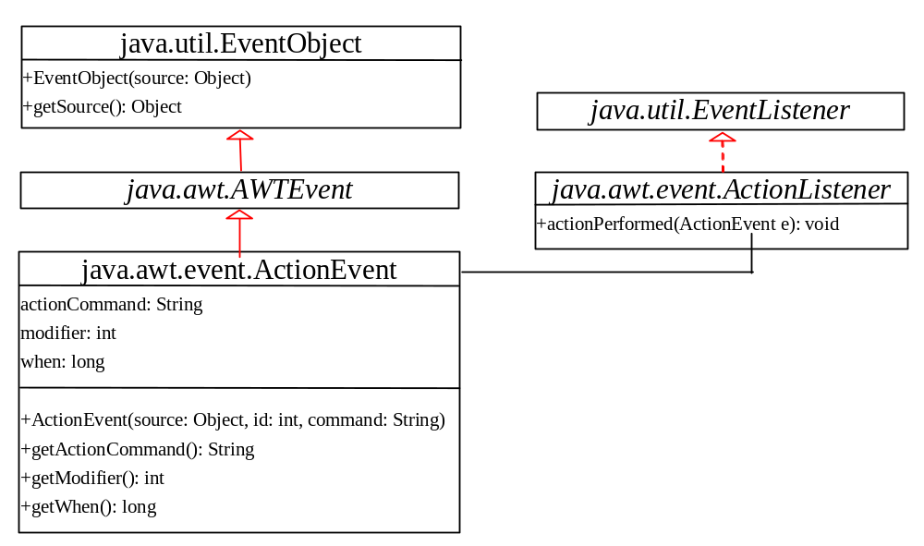
Examples of Event Pairs

Slide 12
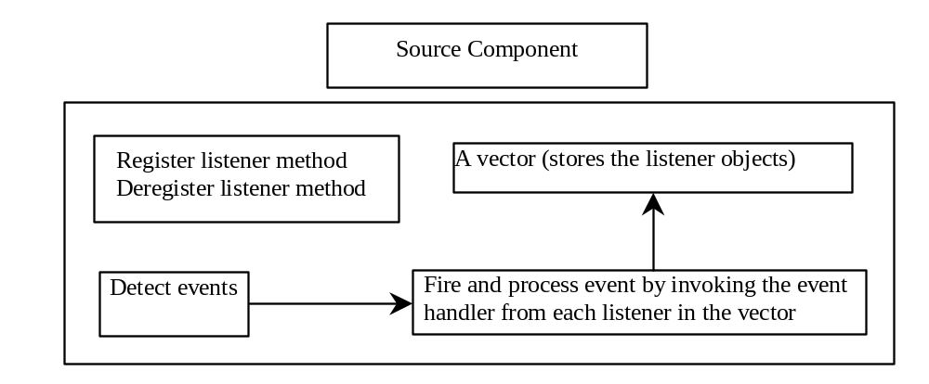
Source Components
The source component detects events and processes the events by invoking the event listeners' handler.

Slide 13
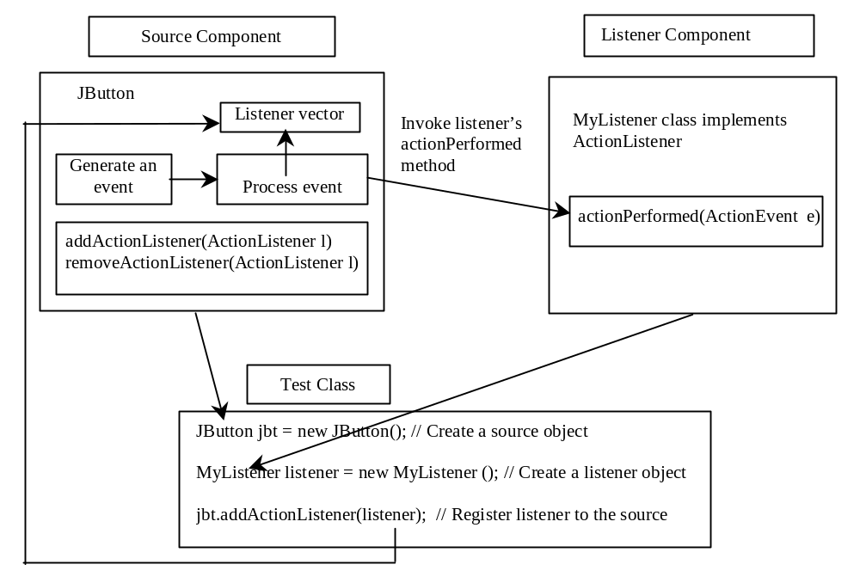
Listener Components
The listener is registered with the source, and the source invokes the listener's handler to process the event.

Slide 14
Creating Custom Source Components
Unicast Registration Methods:
A source component must have the appropriate registration and deregistration methods for adding and removing listeners. Events can be unicasted (only one object is notified of the event) or multicasted (each object in a list of listeners is notified of the event). The naming pattern for adding a unicast listener is
    public void add<Event>Listener(<Event>Listener l) throws TooManyListenersException;

Slide 15
Creating Custom Source Components
Multicast Registration Methods:
The naming pattern for adding a multicast listener is the same, except that it does not throw the TooManyListenersException.
    public void add<Event>Listener(<Event>Listener l)
The naming pattern for removing a listener (either unicast or multicast) is:
    public void remove<Event>Listener(<Event>Listener l)
A source component contains the code that creates an event object and passes it to the listening components by calling a method in the listener's event listener interface. You may use a standard Java event class like ActionEvent to create event objects or may define your own event classes if necessary.

Slide 16
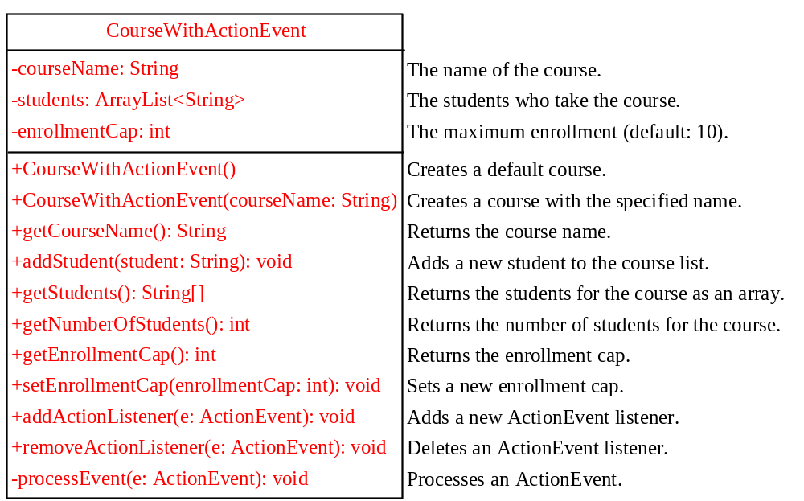
Example: Creating a Source Component
CourseWithActionEvent
TestCourseWithActionEvent
TestCourseWithActionEvent

Slide 17
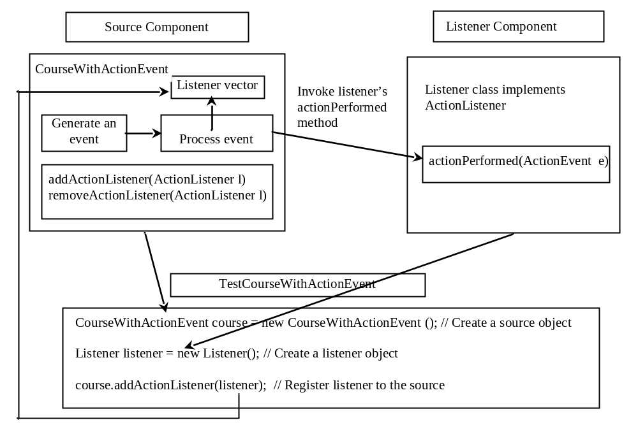
Interaction Between Source and Listener Components
The listener is registered with the source course, and the source invokes the listener's handler actionPerformed to process the event.

Slide 18
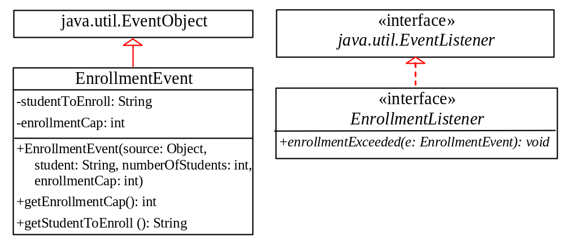
Example: Creating a Custom Event Set
Problem: This example creates a custom event named EnrollmentEvent for describing enrollment events, and its corresponding listener interface EnrollmentListener for defining an enrollmentExceeded handler.
EnrollmentEvent
EnrollmentListener

Slide 19
Creating Custom Event Pairs
You have already used event sets (e.g., ActionEvent/ActionListener) and event source components (JButton) in Java GUI programming. You can create your own event sets and source components.
A custom event class must extend java.util.EventObject or a subclass of java.util.EventObject. Additionally, it may provide constructors to create events, data members and methods to describe the event.
A custom event listener interface must extend java.util.EventListener or a subinterface of java.util.EventListener, and define the signature of the handlers for the event. By convention, the listener interface should be named <Event>Listener for the corresponding event class named <Event>.

Slide 20
Example: Source Component Using Custom Event Pairs
CourseWithEnrollmentEvent
TestCourseWithEnrollmentEvent

Slide 21
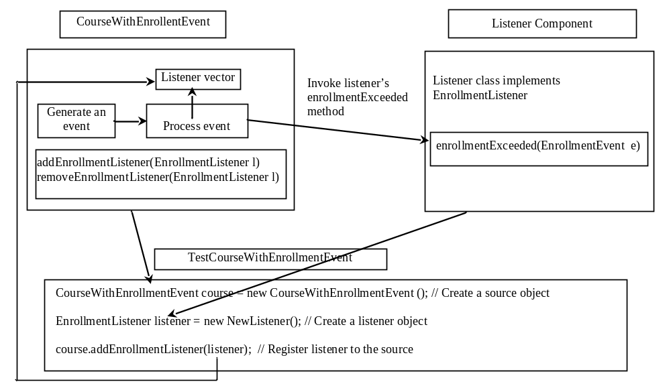
Interaction Between Source and Listener Components
The listener is registered with the source course, and the source invokes the listener's handler enrollmentExceeded to process the event.

Slide 22
Note to the Instructor
You may cover Chapter 36, “MVC and Swing Models,” now.

